Slide 1
Check Zipcode
Yao Shen, Ojonugwa Oji

Slide 2
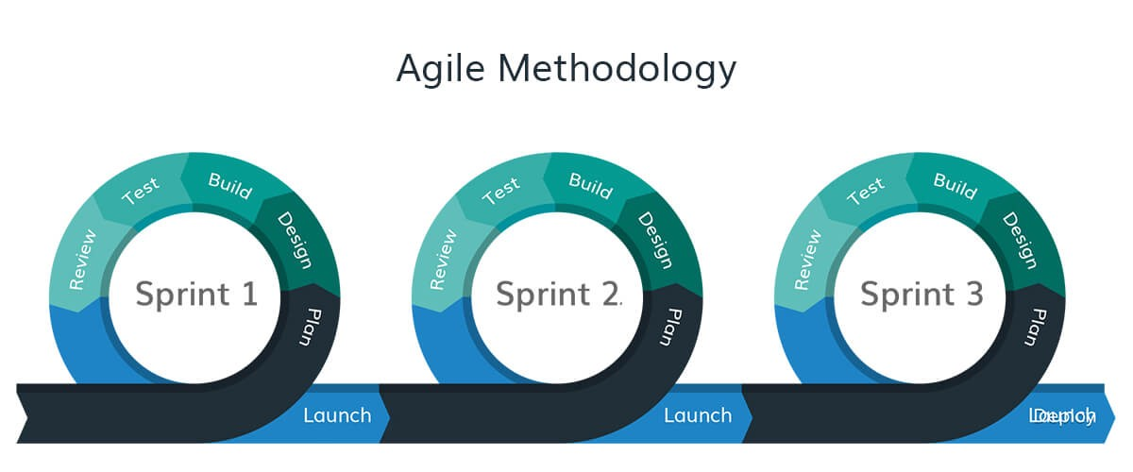
Agile Software Development

Slide 3
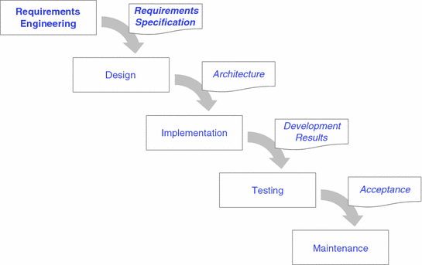
Requirements Engineering

Slide 4
Architectural Design

Slide 5
Design & Implementation

Slide 6
Dependability & Security

Slide 7
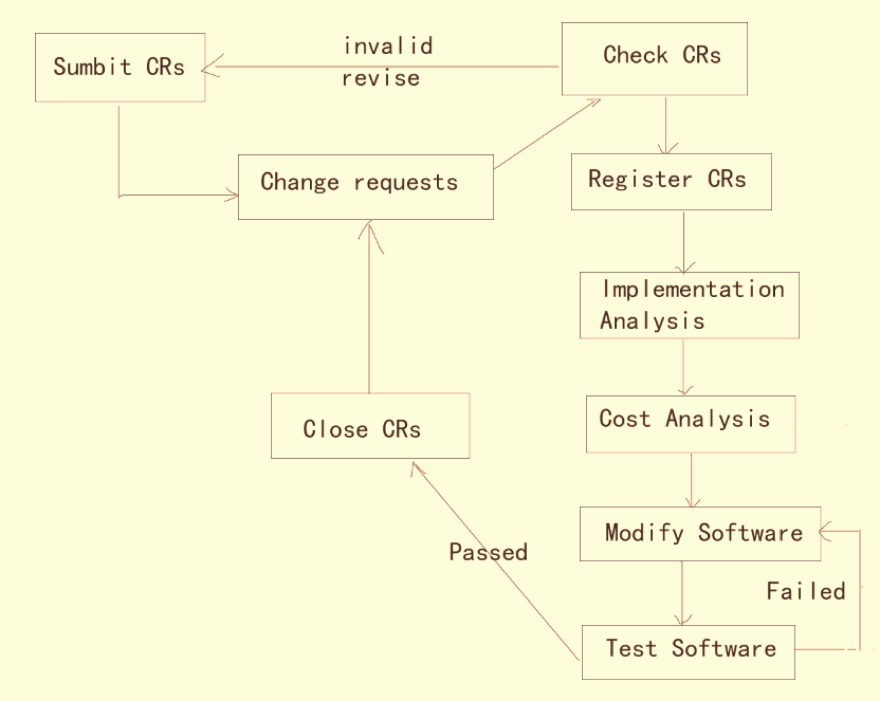
Quality Management

Slide 8
Change Management

Slide 9
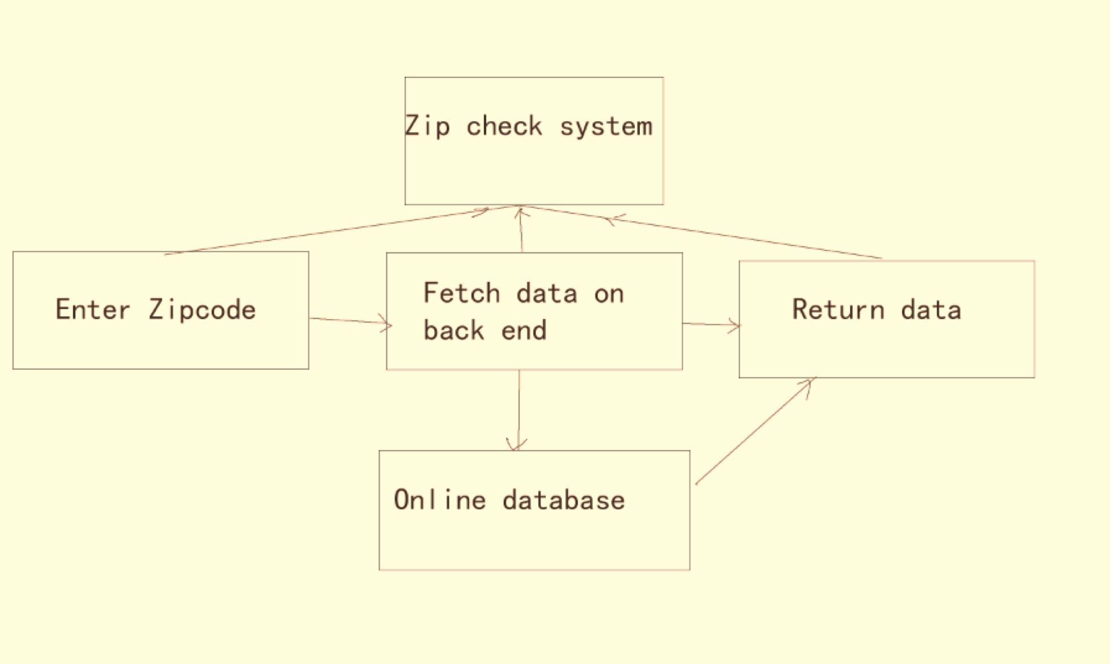
System Modeling

Slide 10
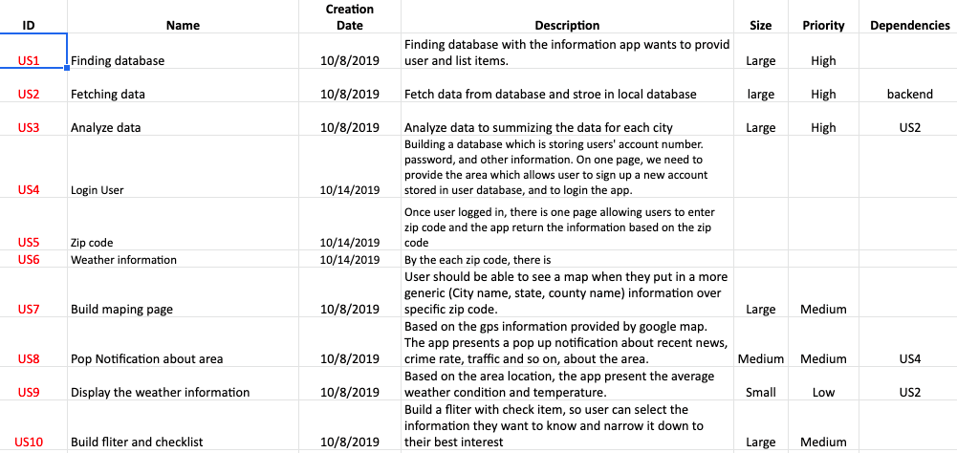
Production Backlog item

Slide 11
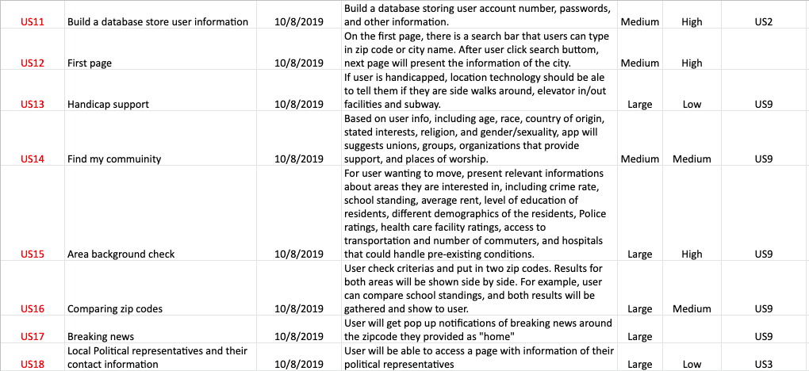
Production Backlog item

Slide 12
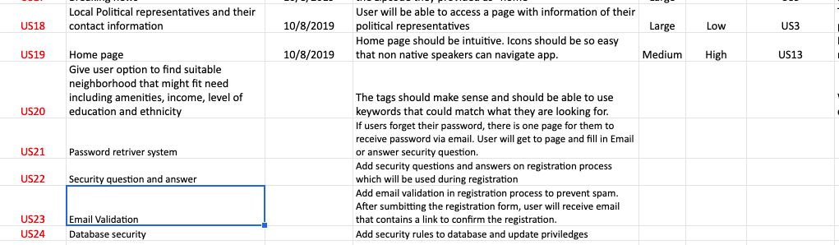
Production Backlog item

